Slide 1
Functions in JavaScript
Understanding Function Concepts, Recursion, and Arrow Functions

Slide 2
Introduction to JavaScript Functions
What is a JavaScript Function?
A block of code designed to perform a specific task.
Functions are executed when they are invoked or called

Slide 3

Function Syntax
JavaScript Function Syntax:
Keyword: function
Name: Function identifier.
Parameters: Listed in parentheses ().
Body: Code to be executed, enclosed in curly brackets {}
Example:

Slide 4
Function Parameters and Arguments
Parameters:
Variables listed as a part of the function definition.
Example: function name(parameter1, parameter2) { ... }
Arguments:
Values passed to the function when it is invoked.
Inside the function, they behave as local variables.

Slide 5

Function Invocation
How to Invoke a Function:
Events: Invoked when an event occurs (e.g., button click).
Direct Call: Invoked from JavaScript code.
Automatically: Self-invoked
Example:

Slide 6
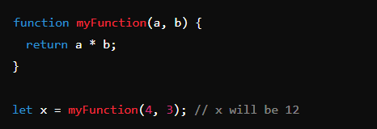
Function Return
Return Statement:
Stops the execution of the function.
Returns a value to the caller.
Example:

Slide 7
Why Use Functions?
Reuse Code:
Write code once, use it multiple times.
Use the same function with different arguments to produce different results.

Slide 8
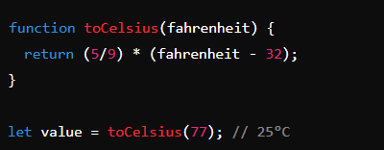
The () Operator
Invoking Functions:
The () operator is used to call the function.
Example:

Slide 9
Functions as Variable Values
Using Functions in Variables:
Functions can be used directly as variable values.
Example:

Slide 10
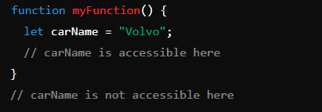
Local Variables
Local Variables:
Declared within a function and can only be accessed inside that function.
Example:

Slide 11
Summary
Key Points:
Functions are reusable blocks of code.
They are invoked using the () operator.
Parameters and arguments allow flexibility.
Functions return values and can be used in expressions.
Local variables are confined to the function scope.

Slide 12
Introduction to Function Types
Overview:
JavaScript supports various types of functions, each with different use cases.
Understanding different function types is crucial for writing clean, efficient, and reusable code.

Slide 13
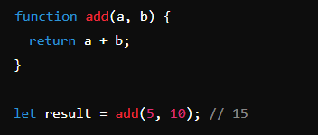
Named Functions
Definition:
Functions that have a name associated with them.
Syntax:
Defined using the function keyword followed by the function name
Example:

Slide 14
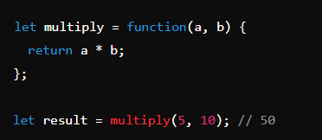
Anonymous Functions
Definition:
Functions without a name.
Often assigned to a variable or used as an argument in other functions.
Example:

Slide 15
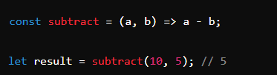
Arrow Functions
Definition:
A concise syntax for writing functions using the => (arrow) operator.
Syntax:
Often used for short functions.
Example:

Slide 16
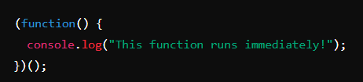
Immediately Invoked Function Expressions (IIFE)
Definition:
Functions that are executed immediately after being defined.
Syntax:
Wrapped in parentheses and followed by () to invoke them.
Example:

Slide 17
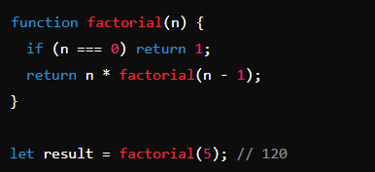
Recursive Functions
Definition:
Functions that call themselves during their execution.
Syntax:
Typically used for problems that can be broken down into smaller, similar problems.
Example:

Slide 18
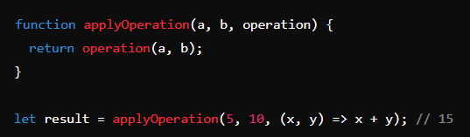
Higher-Order Functions
Definition:
Functions that take other functions as arguments or return them as results.
Syntax:
Commonly used in functional programming.
Example:

Slide 19
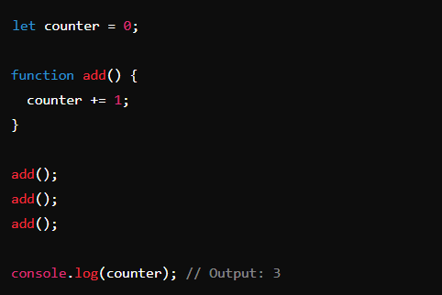
Closure Function

Slide 20
Summary of Functions
Nested Functions: Functions within functions.
Closures: Functions with persistent lexical scope.
Arrow Functions: Concise syntax for functions.
IIFE: Functions that execute immediately.
Function Definition Methods: Declaration, Expression, Arrow, IIFE.
Recursion: Functions calling themselves.
Parameters & Return Types: Passing values and getting results from functions.

